Slide 1


LexiLoom
Chinese Idiom
Learning Platform
Sprint 3 Presentation
Group 12

Slide 2
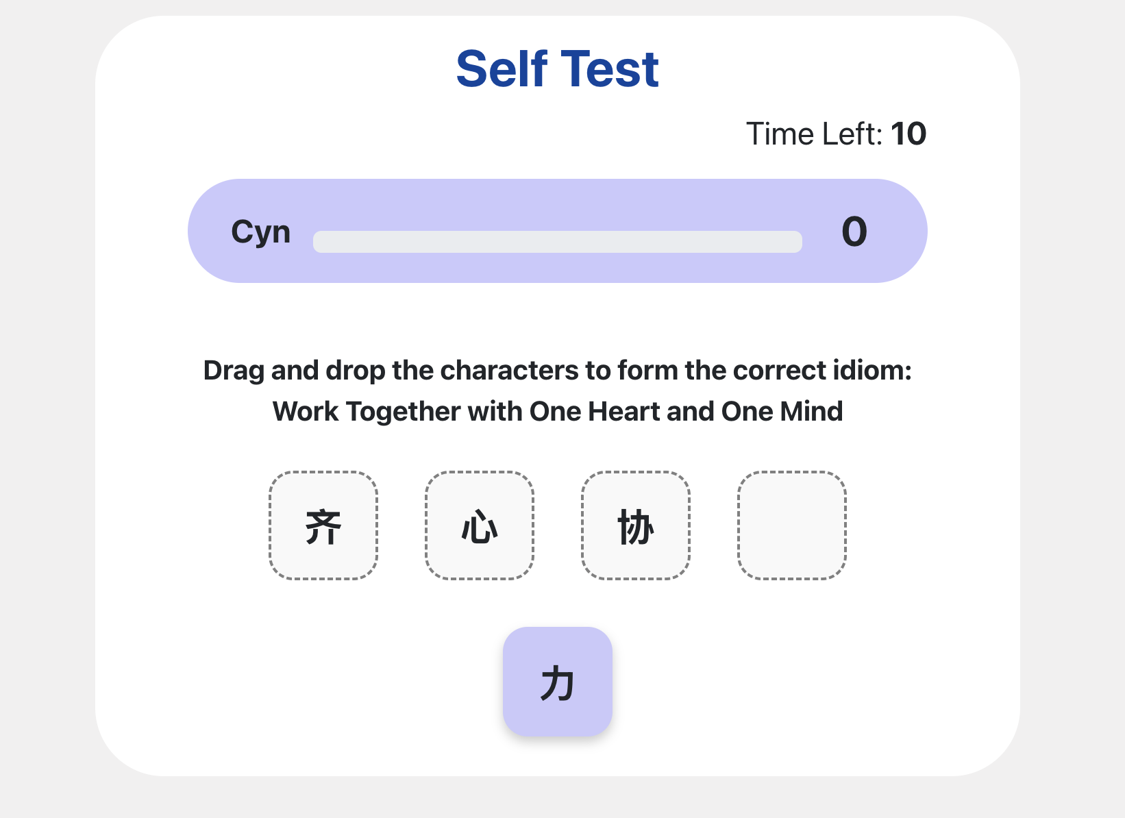
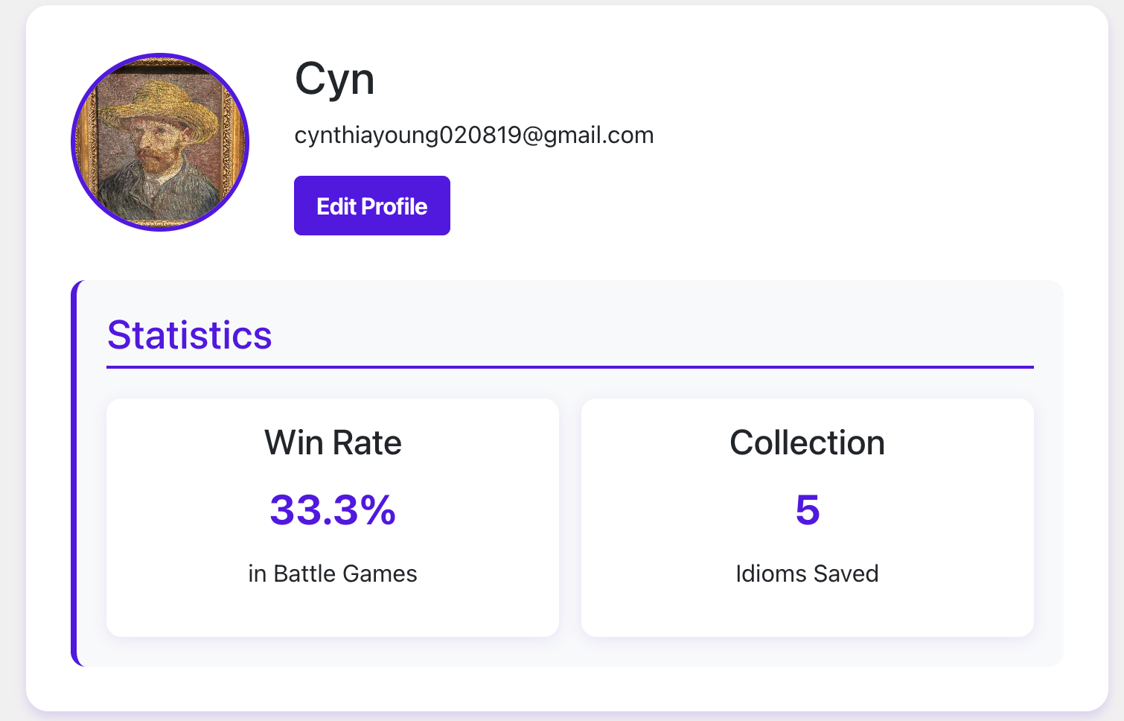
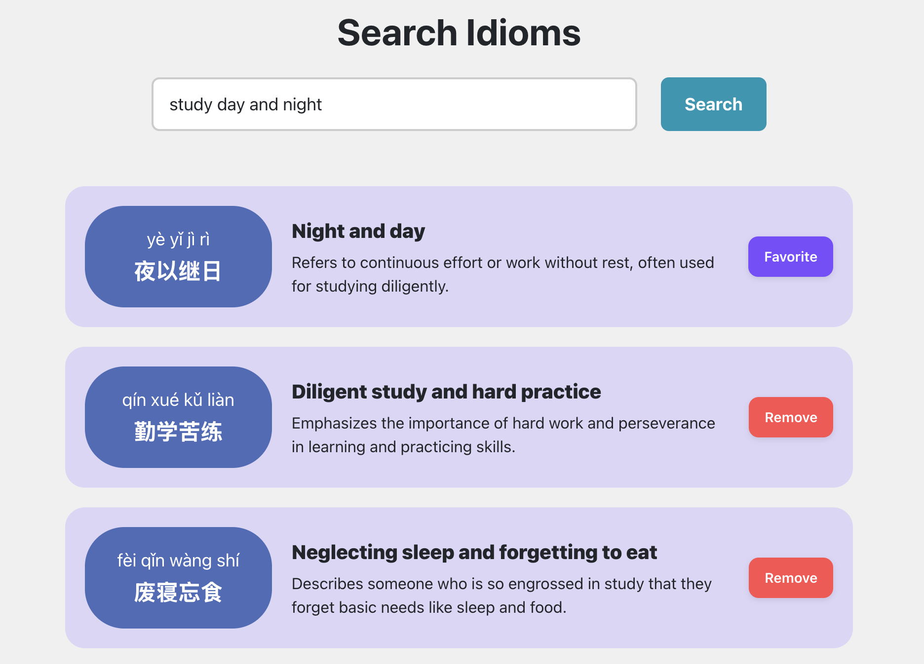
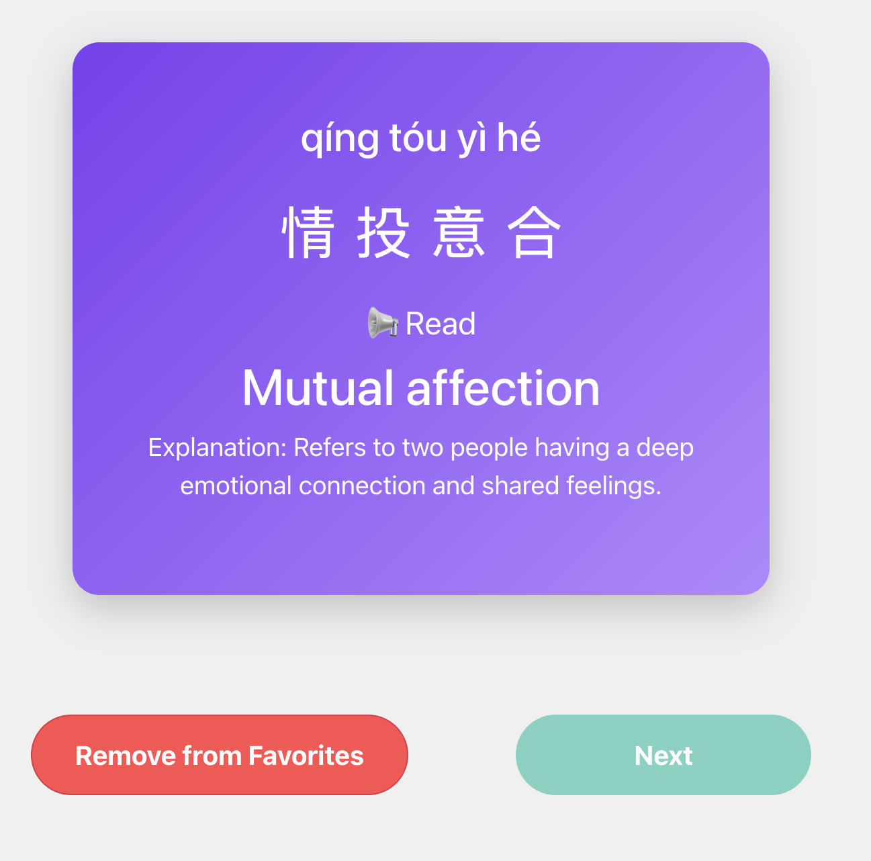
Main Functionalities
Login / Register
My Profile
Learning Module
Flash Cards
Idiom search (through AI)
Collections
Gaming Module
Self -Testing
Game Battle

Slide 3

Sprint 3 ACHIEVEMENTS
Group 12
Flash Card
Login/Register
Game Battle / Self Testing
Add Character Translation
Add Idioms Pronunciation
Fix Google OAuth CSS
Set Google account Avatar as default user profile picture
New Question Type
WebSocket Supported Opponent Match and Game Battle
Game Preparation Page
Handling Opponent Exit
Collection
Profile
Add Paging Feature
AI Search
Show User Info & User Stats
Change User Info & Avatar
AI searched Idioms automatically added to database
Add/Remove AI searched Idioms to Collection

Slide 4
Goals of Next Sprint
Product Owner: Qianhui Long
Sprint backlog:
Rectify: Username changes not updating immediately in the navigation bar & @csrf_exempt decorator on views
Beautify: Pop-up character translation style
Deploy: Cloud platform setup and deployment
Validate:
Functional Testing: Test the complete user flow from registration to using all features
Load Testing: Simulate increased load to ensure stability
Security Testing: Identifies vulnerabilities in your application that could be exploited.

Slide 5
THANK YOU!

Slide 6
Questions
From a functionality perspective, has our web application met the requirements? Do we need to add any new features, or can we focus on deployment and testing now?
For next week's demo presentation, will we only be going through the user flow, or will you also be attempting to inject vulnerabilities? Do you have any tips for us?
Will individual scores within the team be evaluated based on the number of lines of code and commit frequency?

